Slide 1
Start Something That Matters
http://www.youtube.com/watch?v=z3G621cw770

Slide 2
Schools for Sudan
Schools For Sudan, is an initiative started last year by World Cultures Latin America/Africa students at Hudson High.
During the 2010-11 school year students raised over $10,000 to support the building of a secondary school in Leer, Sudan.

Slide 3
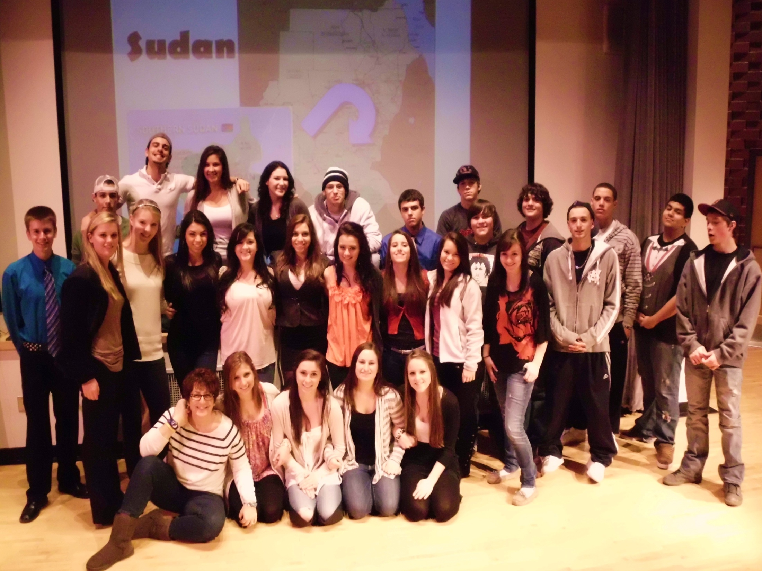

Slide 4
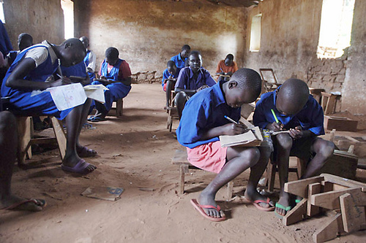
We have lockers, they have mud walls.

Slide 5
Students did presentations in 4th and 5th grade classes throughout the district to share what they had learned about Sudan and inspire others to take action.

Slide 6
This year Schools For Sudan inspired students to document their lives through words and photography.
World Cultures students responded to writing prompts related to 15 Words
(A project inspired by EPHAS, Every Person Has a Story, a non-profit that…: shares stories and connects people around the world through the power of photography.” ephas.org).

Slide 7
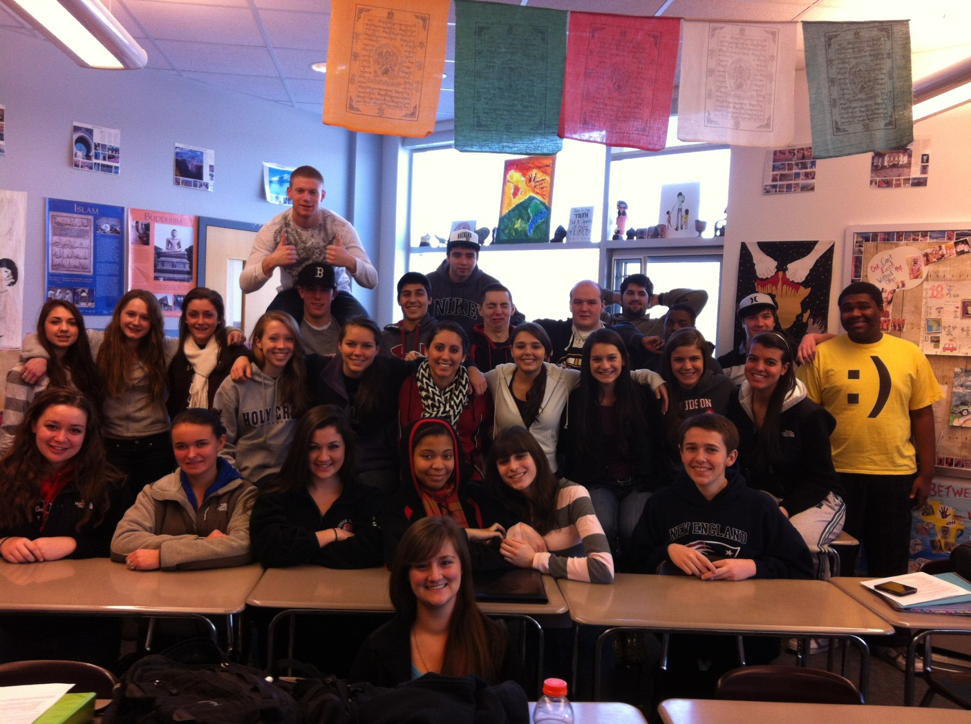

Slide 8
Our Lives in 15 Words
BEAUTY
COMPASSION
EDUCATION
FAMILY
FEAR
FRUSTRATION FUNNY
HOME
HOPE
INNOCENCE
JOY
LOSS
NOURISHMENT
PAIN
WASTE

Slide 9
COMPASSION
“A bit of fragrance always clings to the hand that gives roses”
-Chinese Proverb
Write about a time when you were compassionate. What led you to act the way you did? What if anything did you gain from the experience?

Slide 10
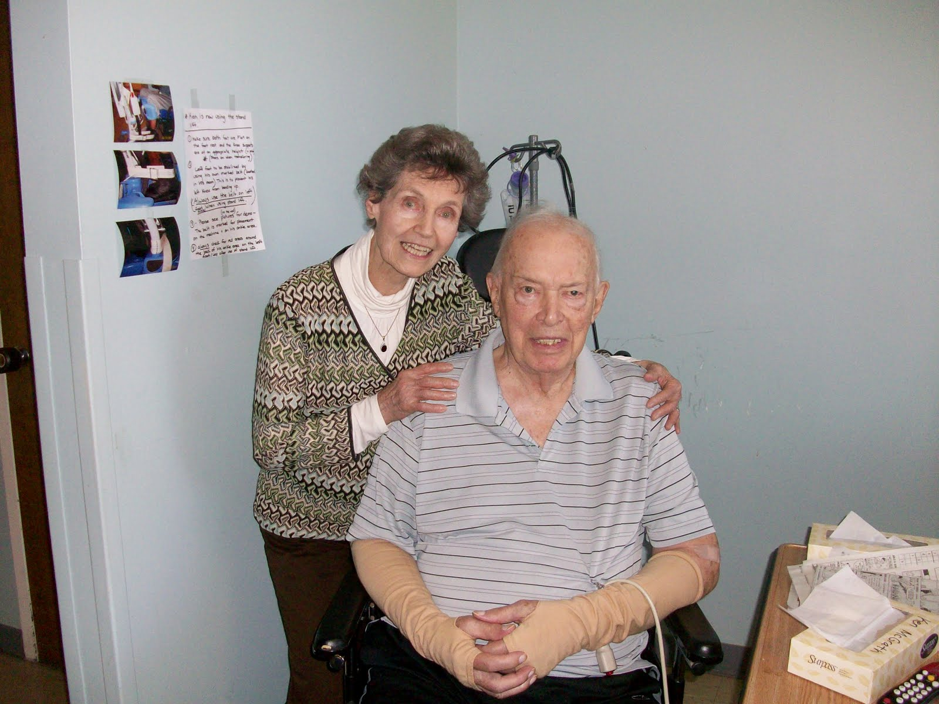
Rachel McGrath, senior

Slide 11
Compassion, what does that word mean to me? I can’t think of a time where I have ever even said the word compassion; it has to mean more than just being nice, and it has to be more than just being a good person.
There has to be something that makes compassion, different.
Sure, I have done plenty of “nice” things for others, but I can’t think of a time when I have truly been compassionate. I don’t know what compassion means. Seventeen years of life and I can’t even define a silly word, nor can I think of a time when it was a part of my life.
Derek Scafidi, junior

Slide 12
FRUSTRATION
What frustrates you most in life? When you get frustrated, how do you respond?

Slide 13
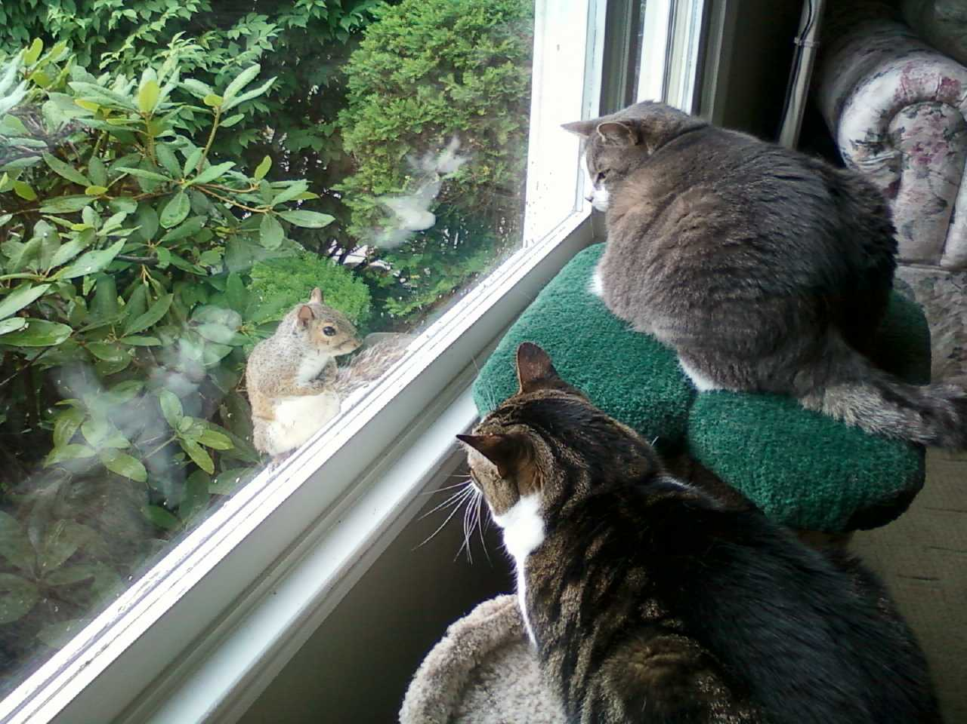
“Here are my two cats, George and Lola, frustrated they can’t get the squirrel.”
Kathryn Volk, senior

Slide 14
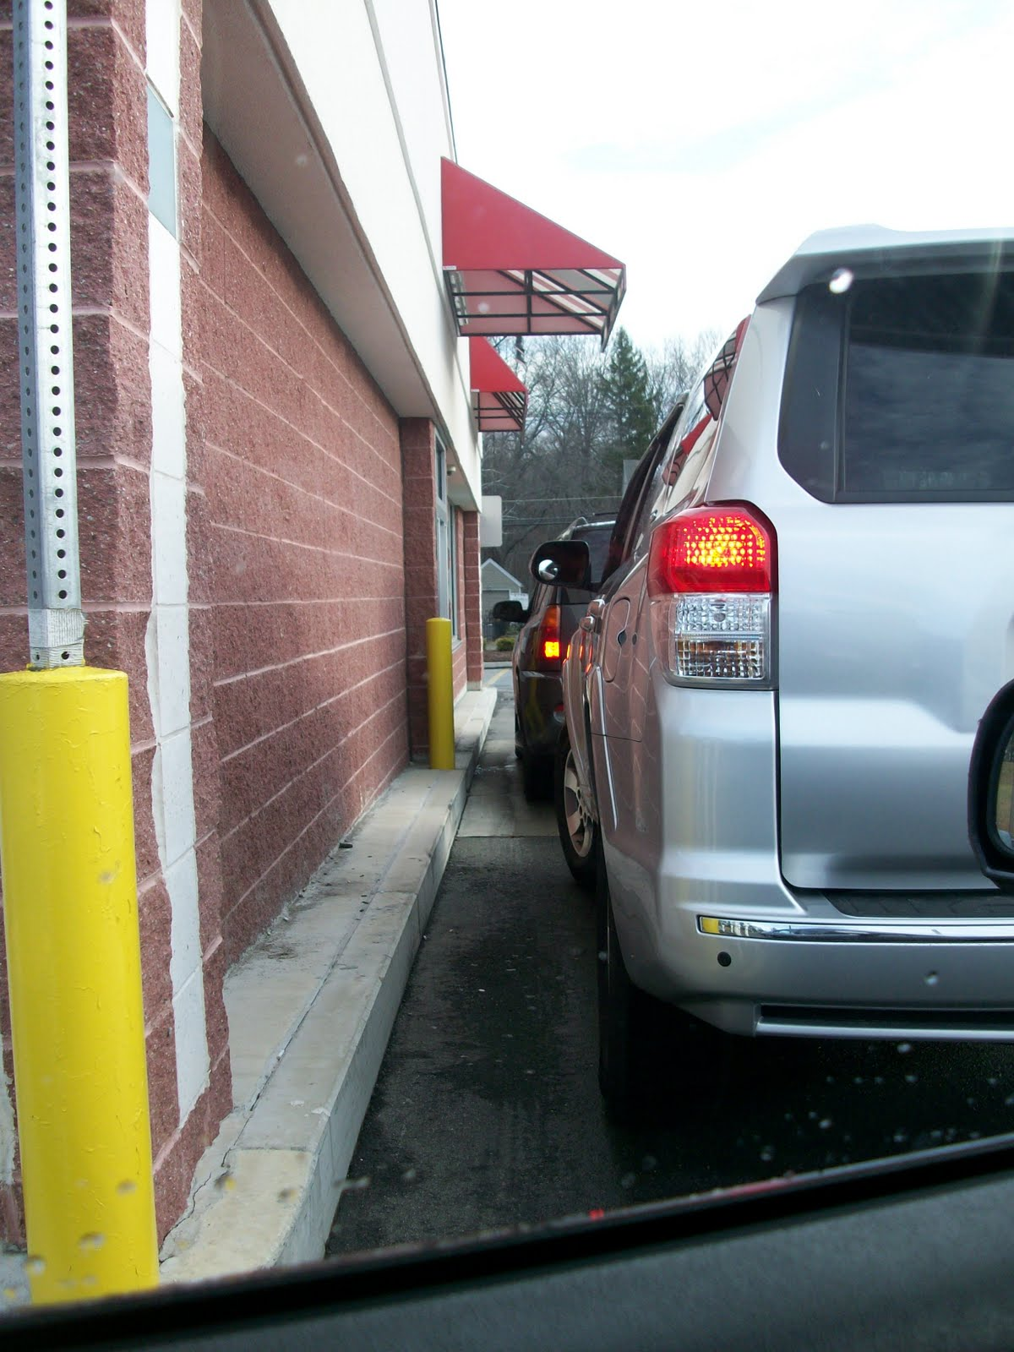
“I hate waiting in lines when I’m in a hurry.”
Rachel McGrath, senior

Slide 15
I get frustrated with a lot of things in my life, but that is part of living life. People get frustrated with many different things, but for me it would have to be school that I get the most frustrated with.
My whole life I just wanted to be successful, to do what I needed, to be good at school. You need good grades to get into a good college to have a good job; which is what I would like for my future.
The reason why school makes me the most frustrated is because of the pressure to do well. When I fail in school it’s like I’m not good enough and that gets me frustrated.
Felipe Tavares, senior

Slide 16
March 5, 2012
“Ms. Murray what are we going to do? We have to do something.”

Slide 17
Goals:
As students, we believe that all children deserve a safe childhood and the right to an education. In our campaign, Be Visible 2012, we will raise awareness and encourage action regarding the injustices that children are currently facing in Central/East Africa.
We plan to visit all the schools in our district and promote community participation.
That participation could be…
Purchasing a Be Visible bracelet (proceeds will go to Schools for Sudan)
E-mailing a government official,
Attending our Be Visible Concert in the Park.

Slide 18
BE
isible
To help get you started, here is an outline of what you could say to one of our local politicians:
Hello, my name is ________.
I want to encourage you to continue to support the deployment of US Military Advisors to Central Africa.
I believe that bringing Joseph Kony to justice is an international obligation. US intervention is essential so that 26 years of tyranny will finally come to an end.
In addition, it is time for the US Senate to ratify the convention on the Rights of the Child, as only Somalia and our country have failed to do so.
Thank you.

